Slide 1
Chapter 8: Deadlocks

Slide 2
Outline
System Model
Deadlock in Multithreaded Applications
Deadlock Characterization
Methods for Handling Deadlocks
Deadlock Prevention
Deadlock Avoidance
Deadlock Detection
Recovery from Deadlock

Slide 3
System Model
Resource types R₁, R₂, . . ., R_{m}
CPU cycles, memory space, I/O devices, mutex, semaphore, …
Each resource type R_{i} has W_{i} instances.
Each thread utilizes a resource as follows:
1. Request: request the resource
2. Use: use the resource
3. Release: release the resource

Slide 4
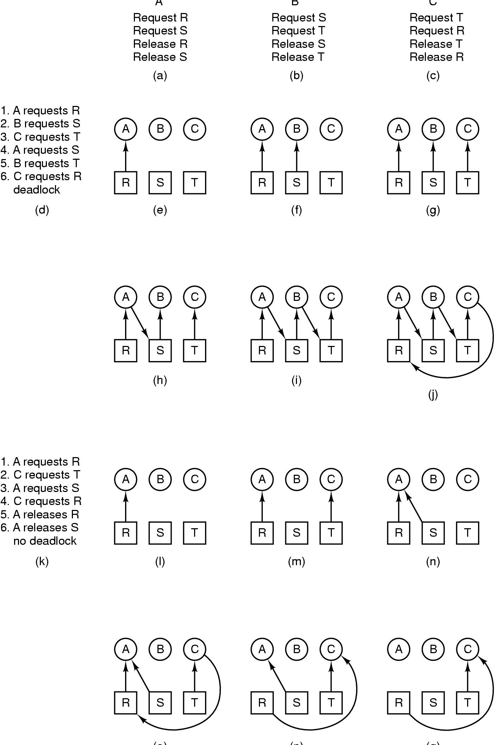
The Deadlock Problem
A B C
From other authors

Slide 5
Outline
System Model
Deadlock in Multithreaded Applications
Deadlock Characterization
Methods for Handling Deadlocks
Deadlock Prevention
Deadlock Avoidance
Deadlock Detection
Recovery from Deadlock

Slide 6
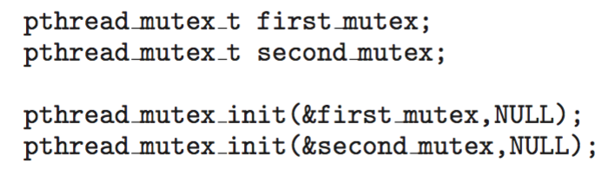
Deadlock in Multithreaded Applications
Example: two mutex locks are created and initialized:

Slide 7
複習: Deadlock Example: Two Threads Acquire Two Mutex in Opposite Order
Example: Let S and Q be two semaphores initialized to 1
thread one thread two
wait (S); wait (Q);
wait (Q); wait (S);
. .
. .
signal (S); signal (Q);
signal (Q); signal (S);
Now, P₀ and P₁ are deadlocked.

Slide 8
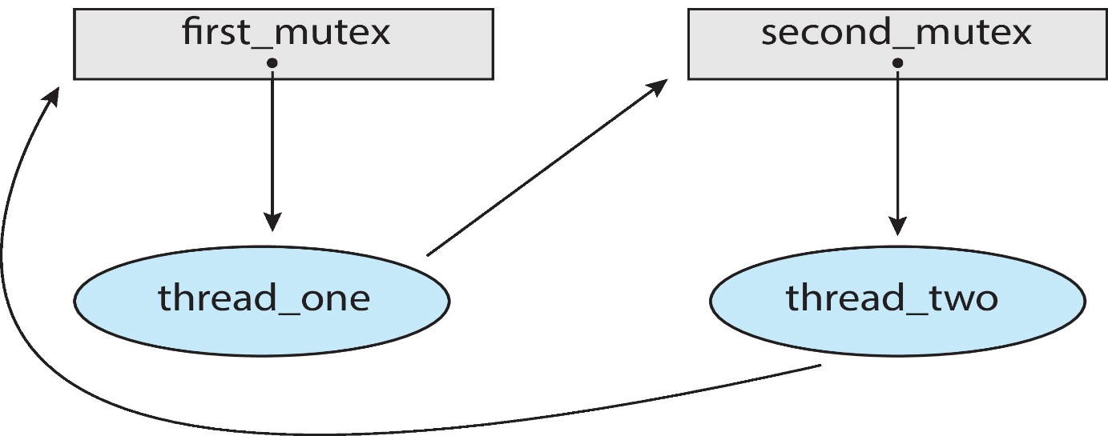
Deadlock Example: Two Threads Acquire Two Mutex in Opposite Order
Deadlock is possible
S
Q

Slide 9
Deadlock in Multithreaded Applications
Problem with handling deadlocks
Difficult to identify since it only occurs under certain scheduling results

Slide 10
Outline
System Model
Deadlock in Multithreaded Applications
Deadlock Characterization
Methods for Handling Deadlocks
Deadlock Prevention
Deadlock Avoidance
Deadlock Detection
Recovery from Deadlock

Slide 11
Deadlock Characterization
Deadlock can arise if four conditions hold simultaneously.
Mutual exclusion: only one thread at a time can use a resource.
Hold and wait: a thread holding resources is waiting to acquire resources held by other threads.
No preemption: a resource can be released only voluntarily.
Circular wait: there exists a set {P₀, P₁, …, P_{n}} of waiting threads such that
P₀ is waiting for a resource that is held by P₁,
P₁ is waiting for a resource that is held by P₂, …,
P_{n–1} is waiting for a resource that is held by P_{n},
And P_{n} is waiting for a resource that is held by P₀.
P₀→P₁→P₂→...→P_{n}→P₀

Slide 12
Resource-Allocation Graph
A set of vertices V and a set of edges E.
V is partitioned into two types:
P = {P₁, P₂, …, P_{n}}, consisting of all the threads.
R = {R₁, R₂, …, R_{m}}, consisting of all resource types.
E has two types
Request edge – directed edge P₁ → R_{j}
Assignment edge – directed edge R_{j} → P_{i}

Slide 13
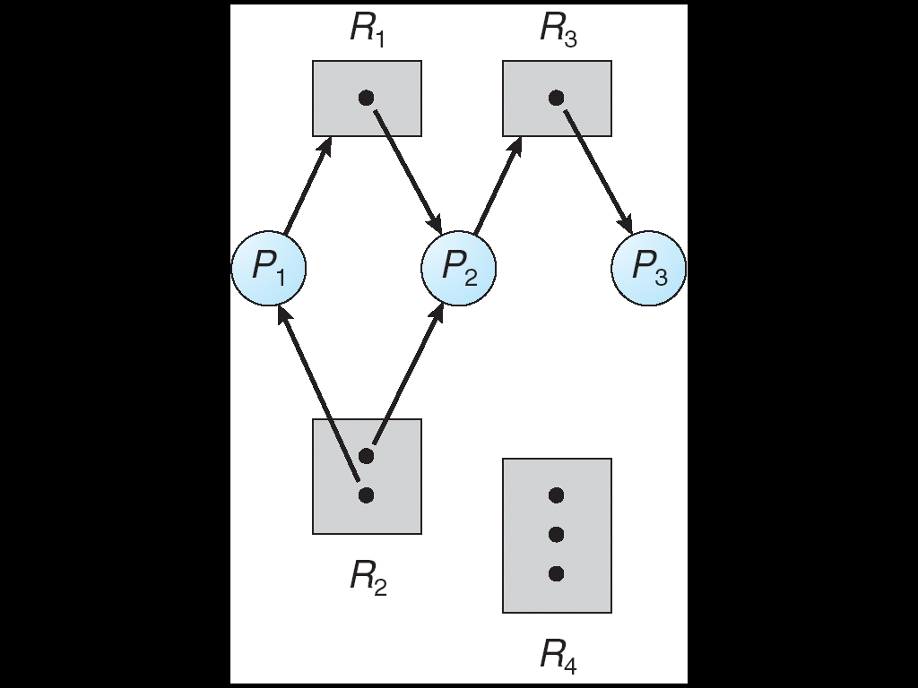
Example of a Resource Allocation Graph
request edge
assignment edge

Slide 14
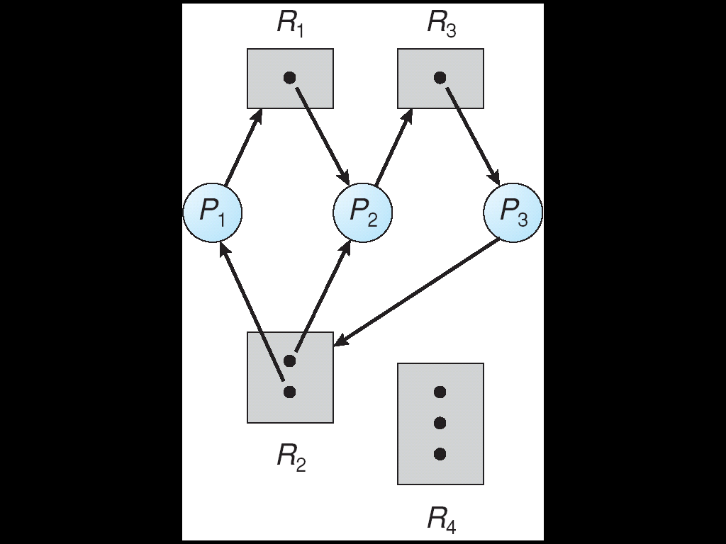
Resource Allocation Graph With A Deadlock
two cycles
P1->R1->P2->R3->P3->R2->P1
P2->R3->P3->R2->P2
(P1, P2, P3) is in deadlock state

Slide 15
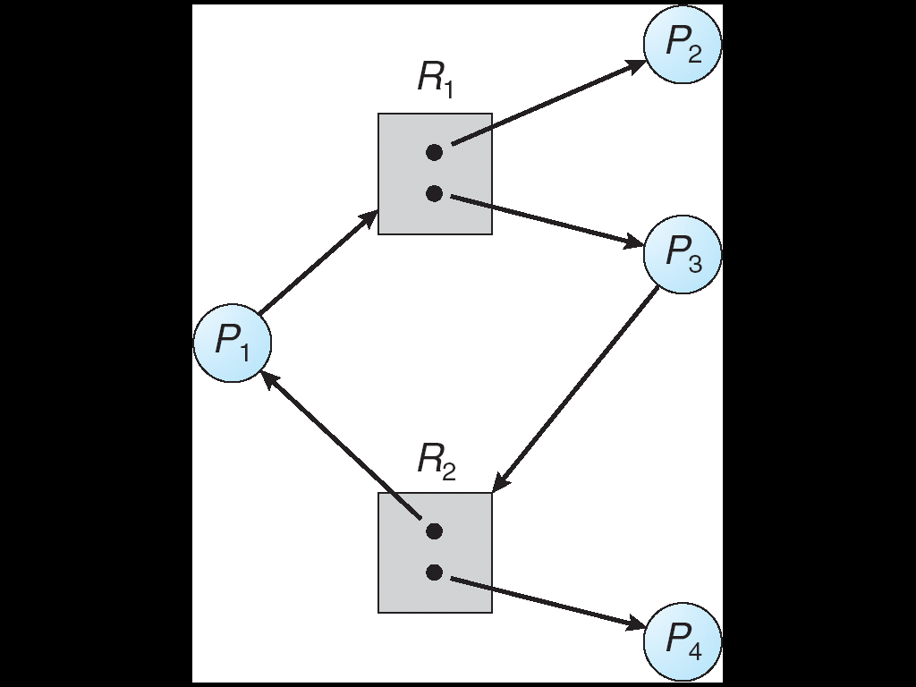
Resource Allocation Graph With A Cycle But No Deadlock
If P4 release R2, then R2 can be assigned to P3

Slide 16
Basic Facts
If graph contains no cycles ⇒ no deadlock.
If graph contains a cycle ⇒
If only one instance per resource type, then deadlock.
If several instances per resource type, possibility of deadlock.
In general, deadlock ⇒ cycle
cycle ⇒ may deadlock
no cycle ⇒ no deadlock
no deadlock ⇒ may have cycle

Slide 17
Outline
System Model
Deadlock in Multithreaded Applications
Deadlock Characterization
Methods for Handling Deadlocks
Deadlock Prevention
Deadlock Avoidance
Deadlock Detection
Recovery from Deadlock

Slide 18
Q: 如何處理deadlock?
Hint: 如何處理感冒?

Slide 19
Methods for Handling Deadlocks
Method 1: ensure that the system will never enter a deadlock state.
Deadlock prevention (預防;阻止(某人去做某事))
Deadlock avoidance (避免(去做某事))
https://tw.voicetube.com/videos/71662
Method 2: allow system to enter a deadlock state and then recover.
Deadlock detection and deadlock recovery
Method 3: ignore the problem
Since deadlock occurs infrequently, say once per month
Used by most OS, including UNIX, Linux, Windows.

Slide 20
Outline
System Model
Deadlock in Multithreaded Applications
Deadlock Characterization
Methods for Handling Deadlocks
Deadlock Prevention
Deadlock Avoidance
Deadlock Detection
Recovery from Deadlock

Slide 21
Deadlock Prevention
Deadlock prevention
Ensuring that at least one of the four conditions cannot hold.
Mutual Exclusion –
Some resources are nonsharable, e.g., printers

Slide 22
Deadlock Prevention (Cont.)
Hold and Wait –whenever a thread requests a resource, it does not hold any other resources.
Method 1 (Hold and no wait): each thread request and be allocated all its resources before execution
Method 2 (Wait and no hold): A thread can request resources only when the thread has none.

Slide 23
Deadlock Prevention (Cont.)
No Preemption –
Only apply to resources whose state can be easily saved and restored (such as CPU, registers, memory)
Cannot applied to resources such as mutex and semaphores

Slide 24
Deadlock Prevention (Cont.)
Circular Wait –
Impose a total ordering of all resource types
Example: F(first_mutex) = 1, F(second_mutex) = 2
Method 1: Each thread requests resources in an increasing order of enumeration.
Accept, If first_mutex➔ second_mutex
Reject, If second_mutex➔ first_mutex
Method 2: Whenever a thread requests resource Rj (SKIP!)
It has released any resources Ri such that F(Ri) > F(Rj)
Ex: if a process holds resources 1, 4, 5 and requests 3 ➔release 4 and 5 first

Slide 25
Deadlock Prevention (Cont.) (Skip!)
Circular Wait –
But, imposing an ordering does not guarantee deadlock prevention
Example: transaction()is a function that transfers funds between two accounts (see the following slides)
Deadlock is possible if two threads simultaneously invoke transaction(), giving two opposite accounts.
Thread 1:
transaction(account1,account2,25.0)
Thread 2 :
transaction(account2,account1,50.0)

Slide 26
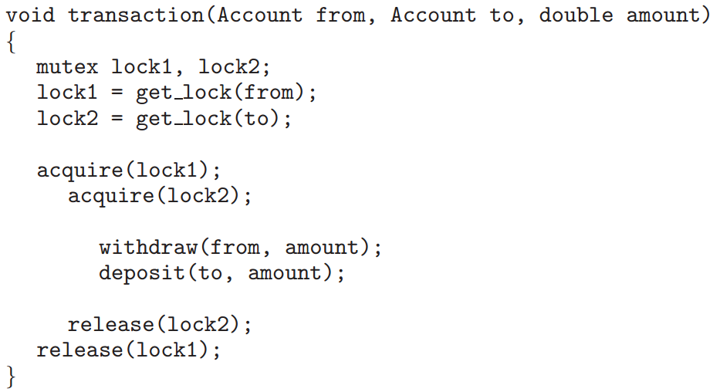
Deadlock Example with Lock Ordering (Skip!)

Slide 27
Deadlock Example with Lock Ordering (Skip!)
Thread 1 | Thread 2
Lock1=get_lock(account1) | ---
Lock2=get_lock(account2)
acquire(Lock1); //lock account1
--- | Lock1=get_lock(account2)
--- | Lock2=get_lock(account1)
 | acquire(Lock1); //lock account2
acquire(Lock2); //blocked //fail to lock account2
 | acquire(Lock2); //blocked //fail to lock account1
deadlock

Slide 28
Outline
System Model
Deadlock in Multithreaded Applications
Deadlock Characterization
Methods for Handling Deadlocks
Deadlock Prevention
Deadlock Avoidance
Deadlock Detection
Recovery from Deadlock

Slide 29
Deadlock Avoidance
Check if the admission of a request may lead to a deadlock (specifically, a circular-wait condition)
Yes => do not admit the request
Requires the system has some additional a priori information.
Each thread must declare the maximum number of resources of each type that it may need
The deadlock-avoidance algorithm dynamically examines the resource-allocation state
Ensure that there can never be a circular-wait condition.

Slide 30
Outline
System Model
Deadlock in Multithreaded Applications
Deadlock Characterization
Methods for Handling Deadlocks
Deadlock Prevention
Deadlock Avoidance
Safe State
Resource-Allocation-Graph Algorithm
Banker’s Algorithm
Deadlock Detection
Recovery from Deadlock

Slide 31
Safe State
System is in safe state if there exists a safe execution sequence of all threads
Definition: system is in safe state (直接看例子）
Formally, there is a safe sequence <P₁,P₂,...,P_{n}> such that for all i=1,2,...,n,
Available+Σ_{1≤k≤i}(Allocated_{k})≥MaxNeed_{i}
Unsafe State
No safe sequence exists
May lead to a deadlock (not must)
From other authors

Slide 32
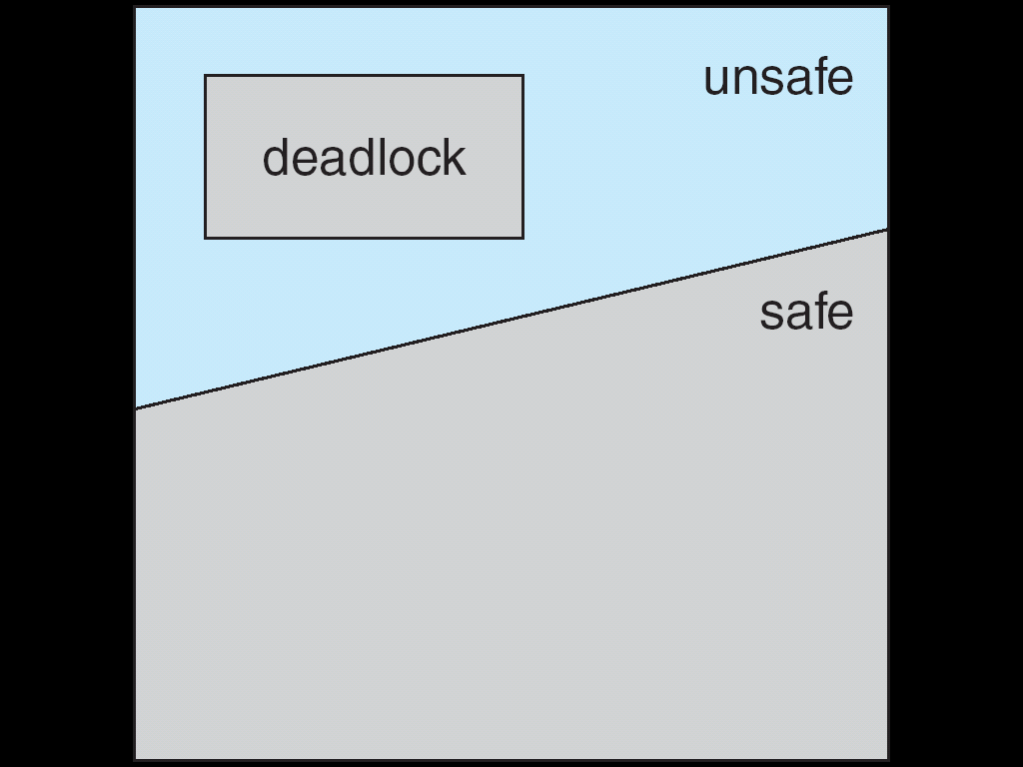
Safe, Unsafe , Deadlock State

Slide 33
Basic Facts
If a system is in safe state ⇒ no deadlocks.
If a system is in unsafe state ⇒ possibility of deadlock.
Deadlock Avoidance ⇒ ensure that a system will never enter an unsafe state.

Slide 34
Example
Each thread must claim maximum use of resources a priori
12 tape drivers in total
maximum needs holds Available
P₀ 10 5 3
P₁ 4 2
P₂ 9 2
Above state is safe: a safe sequence: (P₁, P₀, P₂)
However, if one more is allocated to P₂ ⇒ unsafe ⇒ may (not must) deadlock
From other authors

Slide 35
Deadlock Avoidance Algorithms
Single instance of a resource type.
Use a resource-allocation graph
Multiple instances of a resource type.
Use the banker’s algorithm

Slide 36
Outline
System Model
Deadlock in Multithreaded Applications
Deadlock Characterization
Methods for Handling Deadlocks
Deadlock Prevention
Deadlock Avoidance
Safe State
Resource-Allocation-Graph Algorithm
Banker’s Algorithm
Deadlock Detection
Recovery from Deadlock

Slide 37
Resource-Allocation Graph Scheme
A variant of resource-allocation graph
Introduce a new edge: claim edge P_{i} → R_{j}
Indicated that thread P_{i} may request resource R_{j} at some time in the future.
Represented by a dashed line.
i.e., resources must be claimed a priori.
Grant a request only if no cycle created.

Slide 38
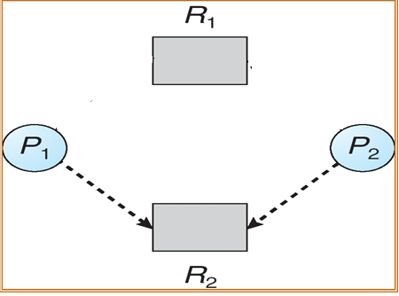
Example
Before executing,
P₁ claims that it will use R₁ and R₂ at some time in the future.
P₂ also claims that it will use R₁ and R₂ at some time in the future.

Slide 39
Example (Cont.)
Then,
P₁ request R₁ and is granted

Slide 40
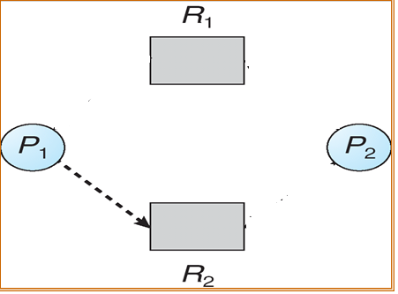
Example: Unsafe State In Resource-Allocation Graph
And then,
P₂ request R₂ and cannot be granted
Otherwise, a cycle occurs

Slide 41
Outline
System Model
Deadlock in Multithreaded Applications
Deadlock Characterization
Methods for Handling Deadlocks
Deadlock Prevention
Deadlock Avoidance
Safe State
Resource-Allocation-Graph Algorithm
Banker’s Algorithm
Deadlock Detection
Recovery from Deadlock

Slide 42
Banker’s Algorithm
Multiple instances.
Each thread must a priori claim maximum use.
Declare the maximum number of instances of each resource type that it may need
When a thread requests a resource, it may have to wait
Even if the requested resources are available

Slide 43
Data Structures for the Banker’s Algorithm (Skip!)
Let n = number of threads, and m = number of resources types.
Available: vector of length m.
If available [j] = k, there are k instances of resource type R_{j} available.
Max: n x m matrix.
If Max [i,j] = k, then thread P_{i} may request at most k instances of resource type R_{j}.
Allocation: n x m matrix.
If Allocation[i,j] = k then P_{i} is currently allocated k instances of R_{j.}
Need: n x m matrix.
If Need[i,j] = k, then P_{i} may need k more instances of R_{j} to complete its task.
Need [i,j] = Max[i,j] – Allocation [i,j].

Slide 44
Safety Algorithm (Skip!)
Let Work and Finish be vectors of length m and n, respectively.
Initialize:
Work = Available
Finish [i] = false for i = 0, 1, …, n- 1.
Find an i such that both:
(a) Finish [i] = false
(b) Need_{i} ≤ Work
If no such i exists, go to step 4.
3. Work = Work + Allocation_{i} Finish[i] = true go to step 2.
4. If Finish [i] == true for all i, then the system is in a safe state.

Slide 45
Resource-Request Algorithm for Thread P_{i} (Skip!)
Request = request vector for thread P_{i}.
If Request_{i} [j] = k then thread P_{i} wants k instances of resource type R_{j.}
If Request_{i} ≤ Need_{i} go to step 2. Otherwise, raise error condition, since thread has exceeded its maximum claim.
If Request_{i} ≤ Available, go to step 3. Otherwise P_{i} must wait, since resources are not available.
Pretend to allocate requested resources to P_{i} by modifying the state as follows:
Available = Available – Request;
Allocation_{i} = Allocation_{i} + Request_{i};
Need_{i} = Need_{i} – Request_{i};
If safe ⇒ the resources are allocated to Pi.
If unsafe ⇒ Pi must wait, and the old resource-allocation state is restored

Slide 46
Example of Banker’s Algorithm
5 threads P₀ through P₄;
3 resource types: A (10 instances), B (5 instances), and C (7 instances).
Snapshot at time T₀:
Allocation Max Available
A B C A B C A B C
P₀ 0 1 0 7 5 3 3 3 2
P₁ 2 0 0 3 2 2
P₂ 3 0 2 9 0 2
P₃ 2 1 1 2 2 2
P₄ 0 0 2 4 3 3
Each thread must claim maximum use of resources a priori

Slide 47
Example of Banker’s Algorithm (Cont.)
The content of the matrix Need is defined to be Max – Allocation.
Need
A B C
P₀ 7 4 3
P₁ 1 2 2
P₂ 6 0 0
P₃ 0 1 1
P₄ 4 3 1
The system is in a safe state
The sequence < P₁, P₃, P₄, P₂, P₀> satisfies safety criteria.

Slide 48
Example: P₁ Request (1,0,2)
1st : Check if Request ≤ Available (that is, (1,0,2) ≤ (3,3,2))⇒ true.
Allocation Need Available
A B C A B C A B C
P₀ 0 1 0 7 4 3 2 3 0
P₁ 3 0 2 0 2 0
P₂ 3 0 2 6 0 0
P₃ 2 1 1 0 1 1
P₄ 0 0 2 4 3 1
2nd : Pretend the request is fulfilled.
Executing safety algorithm shows that sequence < P₁, P₃, P₄, P₀, P₂> satisfies safety requirement.

Slide 49
Example of Banker’s Algorithm (Cont.)
After previous successful allocation
Can request for (3,3,0) by P4 be granted? No, > available
Can request for (0,2,0) by P0 be granted? No, unsafe (see the next slide)

Slide 50
Example: P₀ Request (0,2,0)
After previous allocation, if P₀ request (0, 2, 0)
Allocation Max Available Need
ABC ABC ABC ABC
P0 0 3 0 7 5 3 2 1 0 7 2 3
P1 3 0 2 3 2 2 0 2 0
P2 3 0 2 9 0 2 6 0 0
P3 2 1 1 2 2 2 0 1 1
P4 0 0 2 4 3 3 4 3 1
No safe sequence ⇒ unsafe
⇒ P₀ must wait even resources are available.

Slide 51
Outline
System Model
Deadlock in Multithreaded Applications
Deadlock Characterization
Methods for Handling Deadlocks
Deadlock Prevention
Deadlock Avoidance
Deadlock Detection
Recovery from Deadlock

Slide 52
Deadlock Detection
Allow system to enter deadlock state
Detect whether deadlocks occur
If so, recover from the deadlock
Detection algorithm
Recovery scheme

Slide 53
Outline
System Model
Deadlock in Multithreaded Applications
Deadlock Characterization
Methods for Handling Deadlocks
Deadlock Prevention
Deadlock Avoidance
Deadlock Detection
Single Instance of Each Resource Type
Several Instance of a Resource Type
Detection-Algorithm Usage
Recovery from Deadlock

Slide 54
Single Instance of Each Resource Type
System must maintain a wait-for graph
A variant of resource-allocation graph by removing resource nodes
Nodes are threads.
P_{i} → P_{j} if P_{i} is waiting for P_{j}.
Then, system must periodically invoke an algorithm that searches for a cycle in the graph.

Slide 55
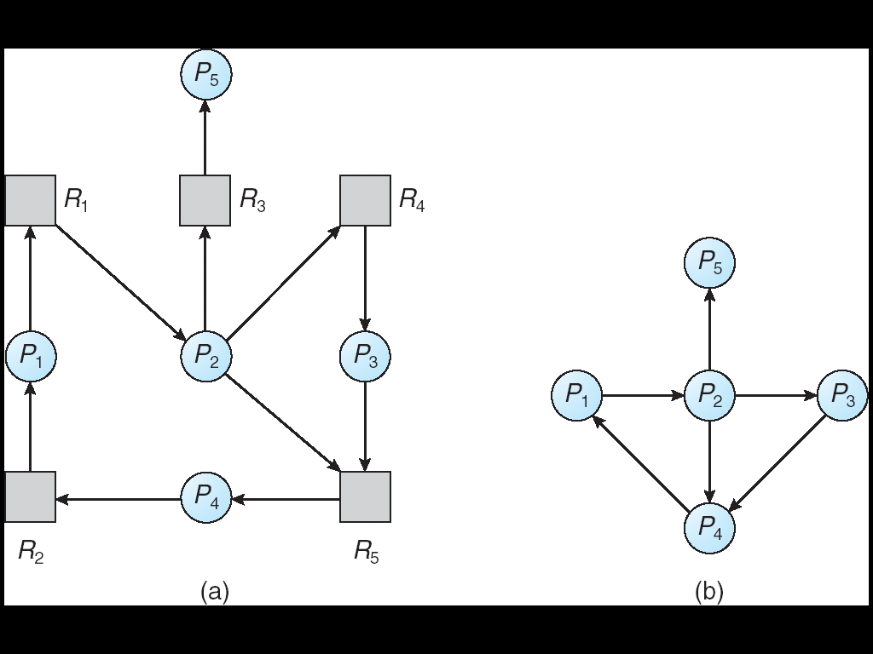
Resource-Allocation Graph and Wait-for Graph
Resource-Allocation Graph
Corresponding wait-for graph

Slide 56
Outline
System Model
Deadlock in Multithreaded Applications
Deadlock Characterization
Methods for Handling Deadlocks
Deadlock Prevention
Deadlock Avoidance
Deadlock Detection
Single Instance of Each Resource Type
Several Instance of a Resource Type
Detection-Algorithm Usage
Recovery from Deadlock

Slide 57
Several Instances of a Resource Type (Skip!)
Available: A vector of length m indicates the number of available resources of each type.
Allocation: An n x m matrix defines the number of resources of each type currently allocated to each thread.
Request: An n x m matrix indicates the current request of each thread.
If Request [i][j] = k, then thread P_{i} is requesting k more instances of resource type R_{j}.

Slide 58
Detection Algorithm (Skip!)
1. Let Work and Finish be vectors of length m and n, respectively Initialize:
(a) Work = Available
(b) For i = 1,2, …, n,
If Allocation_{i} ≠ 0, then Finish[i] = false;
Otherwise, Finish[i] = true.
2. Find an index i such that both:
(a) Finish[i] == false
(b) Request_{i} ≤ Work
If no such i exists, go to step 4.

Slide 59
Detection Algorithm (Cont.) (Skip!)
3. Work = Work + Allocation_{i} Finish[i] = true go to step 2.
If Finish[i] == false, for some i, 1 ≤ i ≤ n, then the system is in deadlock state. Moreover, if Finish[i] == false, then P_{i} is deadlocked.
Algorithm requires an order of O(m x n²⁾ operations to detect whether the system is in deadlocked state.

Slide 60
Example of Detection Algorithm
Five threads P₀ ~ P₄;
Three resource types: A (7 instances), B (2 instances), and C (6 instances).
Snapshot at time T₀:
Allocation Request Available
A B C A B C A B C
P₀ 0 1 0 0 0 0 0 0 0
P₁ 2 0 0 2 0 2
P₂ 3 0 3 0 0 0
P₃ 2 1 1 1 0 0
P₄ 0 0 2 0 0 2
Sequence <P₀, P₂, P₃, P₁, P₄> will result in Finish[i] = true for all threads.
the current request of each thread

Slide 61
Detection Algorithm (Cont.)
Here, the algorithm takes an optimistic attitude
Assume P_{i} will require no more resources
It will thus soon return all allocated resources.
However, if the assumption may be wrong
A deadlock may occur later
It’s purpose is not to “avoid” deadlock
Only detect deadlock at “current” time
Don’t worry
The deadlock will be detected later when deadlock-detection algorithm is invoked.

Slide 62
Example (Cont.)
If P₂ requests an additional instance of type C.
Request
A B C
P₀ 0 0 0
P₁ 2 0 2
P₂ 0 0 1
P₃ 1 0 0
P₄ 0 0 2
State of system?
Can reclaim resources held by P₀, but insufficient to fulfill other threads’ requests.
Deadlock exists, consisting of threads P₁, P₂, P₃, and P₄.

Slide 63
Deadlock Detection Algorithm v.s. Deadlock Avoidance Algorithm
The deadlock-detection algorithm is similar to the deadlock-avoidance algorithm
But it uses the current requests rather than maximum claim
Since it does not avoid deadlock
In general, deadlock avoidance is more expensive than deadlock detection:
It must be executed for every request
Restricts resource utilization ⇨ degrade system performance.
Assumes that the "worst-case" request sequence.

Slide 64
Outline
System Model
Deadlock in Multithreaded Applications
Deadlock Characterization
Methods for Handling Deadlocks
Deadlock Prevention
Deadlock Avoidance
Deadlock Detection
Single Instance of Each Resource Type
Several Instance of a Resource Type
Detection-Algorithm Usage
Recovery from Deadlock

Slide 65
Detection-Algorithm Usage
When, and how often, to invoke detection algorithm?
Example
When a resource request cannot be granted
Invoked periodically
Once per hour
Invoked at specific situations
When the CPU utilization drops below 40 percent

Slide 66
Outline
System Model
Deadlock in Multithreaded Applications
Deadlock Characterization
Methods for Handling Deadlocks
Deadlock Prevention
Deadlock Avoidance
Deadlock Detection
Recovery from Deadlock

Slide 67
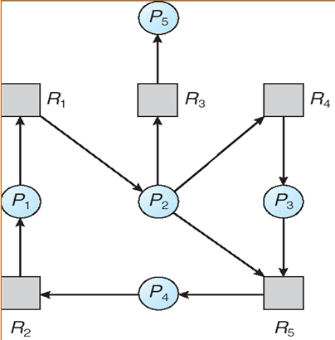
Recovery from Deadlock
Recover from the deadlock
Method 1: thread termination
Method 2: resource preemption

Slide 68
Recovery from Deadlock: Thread Termination
Two choices
Abort all deadlocked processes/threads.
Great expense
Abort one process/thread at a time until the deadlock cycle is eliminated.

Slide 69
Recovery from Deadlock: Resource Preemption
Preempt some resources from some threads and give the resources to other threads
Three issues (skip!)
Selecting a victim – minimize cost.
Which resources are to be preempted
Rollback – since victim thread missing needed resource
Must return to some safe state, restart it from that state.
However, not easy to determine a safe state
Just abort the thread and restart it
Starvation – same thread may always be picked as victim,
Solution: include the number of rollback in cost factor.

Slide 70
Detection-and-Recovery Scheme
Disadvantages of detection-and-recovery scheme
Run-time costs
Maintain information and execute the detection algorithm
Potential losses in recovering from a deadlock

Slide 71
複習：Methods for Handling Deadlocks
Method 1: ensure that the system will never enter a deadlock state.
Deadlock prevention (預防;阻止(某人去做某事))
Deadlock avoidance (避免(去做某事))
https://tw.voicetube.com/videos/71662
Method 2: allow system to enter a deadlock state and then recover.
Deadlock detection and deadlock recovery
Method 3: ignore the problem
Since deadlock occurs infrequently, say once per month
Used by most operating systems, including UNIX, Linux, Windows.

